Slide 1

Fantasy Book Recommender
Maria Scott
Metis Winter 2020
“The four most engaging words in any language are … Once upon a time.” Steven Spielberg
Notes:
While I really enjoy my kindle
the book recommendations it gives
often times leave me thinking …why?
So I decided to use this project to explore that process

Slide 2

The Corpus
Wikipedia Application Program Interface
Constrained scope to “Fantasy”
2,290 book titles and summaries
Notes:
Learned Wikipedia has an API for exploring books.
It took a few iterations of pulling data to learn the API learn how the API would return data.
Pulled nearly 2,300 titles and
book Summaries from the “Fantasy” genre.
I limited to 1 genre as this project iteration is basically Proof of Concept
BUT I wanted a genre that would have a broad appeal.

Slide 3

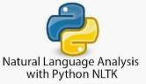

The Process
Data Acquisition
Data Cleanse
spaCy for Named Entity Recognition
NLTK + Custom stop words
Vectorize
Term Frequency-Inverse Document Frequency
Notes:
Acquisition:
Preprocessing / Cleanse :
Remove publications that were lists of books and articles that were not books.
I used spaCy for Named Entity Recognition
and NLTK and Custom Stop words to refine the data in preparation for vectorizing
Vectorize:
Using TF-IDF vectorizer tuning the n_gram range, minimum and maximum frequency
parameters to shape the final vector
-tuning ngram_range -min_df: ignore terms that have a document frequency lower than a threshold. terms that appear too infrequently -max_df: ignore terms that have a frequency higher than a threshold. is used for removing data values that appear too frequently
TFID which accounts for the number of times a term occurs in a document, the inverse factor gives more weight to less frequent words
tuned ngram range min_df, and max_df
The Natural Language Toolkit (NLTK) is a platform used for building Python programs that work with human language data for applying in statistical natural language processing (NLP). It contains text processing libraries for tokenization, parsing, classification, stemming, tagging and semantic reasoning

Slide 4

The Process continued
Topic Modeling
Latent Dirichlet Allocation (LDA)
Recommendation Engine
Number of topics?
Recommendation Flask Application
Notes:
Topic Modeling
From there I tried both NMF and LDA for Topic modeling,
Right off the bat LDA topics made more sense.
Continued to run both
As I refined the stop words, Which was VERY MUCH an iterative process,
eventually the WORD GROUPS
returned by the Models started actually forming general Topics. Yaaaa!
NOTES to SELF
Non-Negative Matrix Factorization: matrix decomposition yields 2 matrices w/ non-neg values,
does not yield a feature rank matrix it can’t go back, can’t 0 out.
LDA is probabilistic approach to generating the document-topic matrix.
Documents are represented as random mix of latent topics, each topic characterized by a distribution of words
Priors are used for the document- topic and term – topic distributions

Slide 5
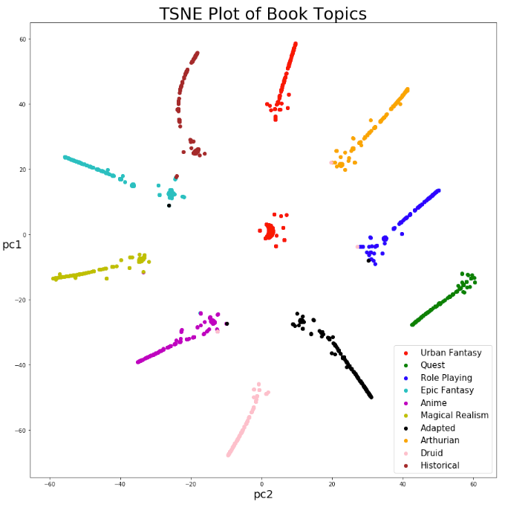
The Process continued
Visualizations
T-Distributed Stochastic Neighbor Embedding (t-SNE))
Graphic to inform Topic Modeling
Notes:
I used t-SNE as a visualization tool.
Data started out as basically one big cloud.
Then I could actually see in the distinct and separated groupings.
Then the question became how many Topics are enough?
A way of visually representing the
T-distributed Stochastic Neighbor Embedding (t-SNE) is a machine learning algorithm for visualization
It is a nonlinear dimensionality reduction technique well-suited for embedding high-dimensional data for visualization in a low-dimensional space of two or three dimensions.
Stage 1:t-SNE constructs a probability distribution over pairs of high-dimensional objects in such a way that similar objects have a high probability of being picked while dissimilar points have an extremely small probability of being picked. Based on Euclidian distance by default, but can be changed. Stage 2: t-SNE defines a similar probability distribution over the points in the low-dimensional map, and it minimizes the Kullback–Leibler divergence (KL divergence) between the two distributions with respect to the locations of the points in the map.

Slide 6
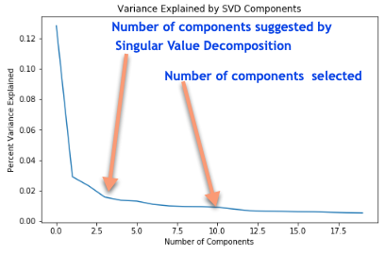
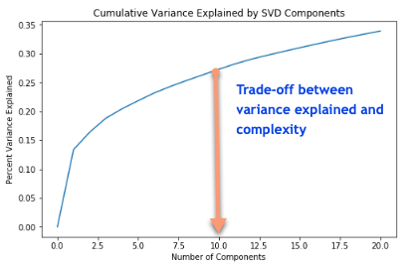
How Many Topics?
What will the User’s experience be?
Notes:
Singular value decomposition indicates 2 or 3 topics is enough.
But what will the user experience be with a recommendation based on 2 topics and 3% of the variation?
It didn’t seem robust enough.
But when to stop? How many is too many?
I chose to use 10 topics while more complex, explains 25% of the variance.
More than that get unmanageable.
Which then leads to what metric to use for the recommender?
I actually made 2 recommendation ENGINES. One based on Euclidian distance and another based on Cosine Similarity.
Elbow Method This method looks at the percentage of variance explained as a function of the number of clusters: One should choose a number of clusters so that adding another cluster doesn't give much better modeling of the data. More precisely, if one plots the percentage of variance explained by the clusters against the number of clusters, the first clusters will add much information (explain a lot of variance), but at some point the marginal gain will drop, giving an angle in the graph. The number of clusters is chosen at this point, hence the "elbow criterion".ined

Slide 7
Recommend Books
Given: “the trio's journey to find the seven missing gems of Deltora braving dangers”
Euclidean Distance
“City of Lost Souls”
“Haunted (Armstrong Novel)”
“Conan and the Gods of the Mountain”
“Conan and the Death Lord of Thanza”
“Chaotic (novella)”
Cosine Similarity
“Dr. Dolittle & the Secret Lake”
“Early Riser”
“Erewhon”
“Varney the Vampire”
“Job: A Comedy of Justice”
Notes:
I fueled each engine with a brief, random excerpt
from a random summary and got back 5 title recommendations
Circled back to the Wikipedia to look at page for that recommendation.
Quite frankly,
Those based on Cosine similarity gave me an experience like my Kindle experience.
So have chosen Euclidean Distance for the Recommender

Slide 8
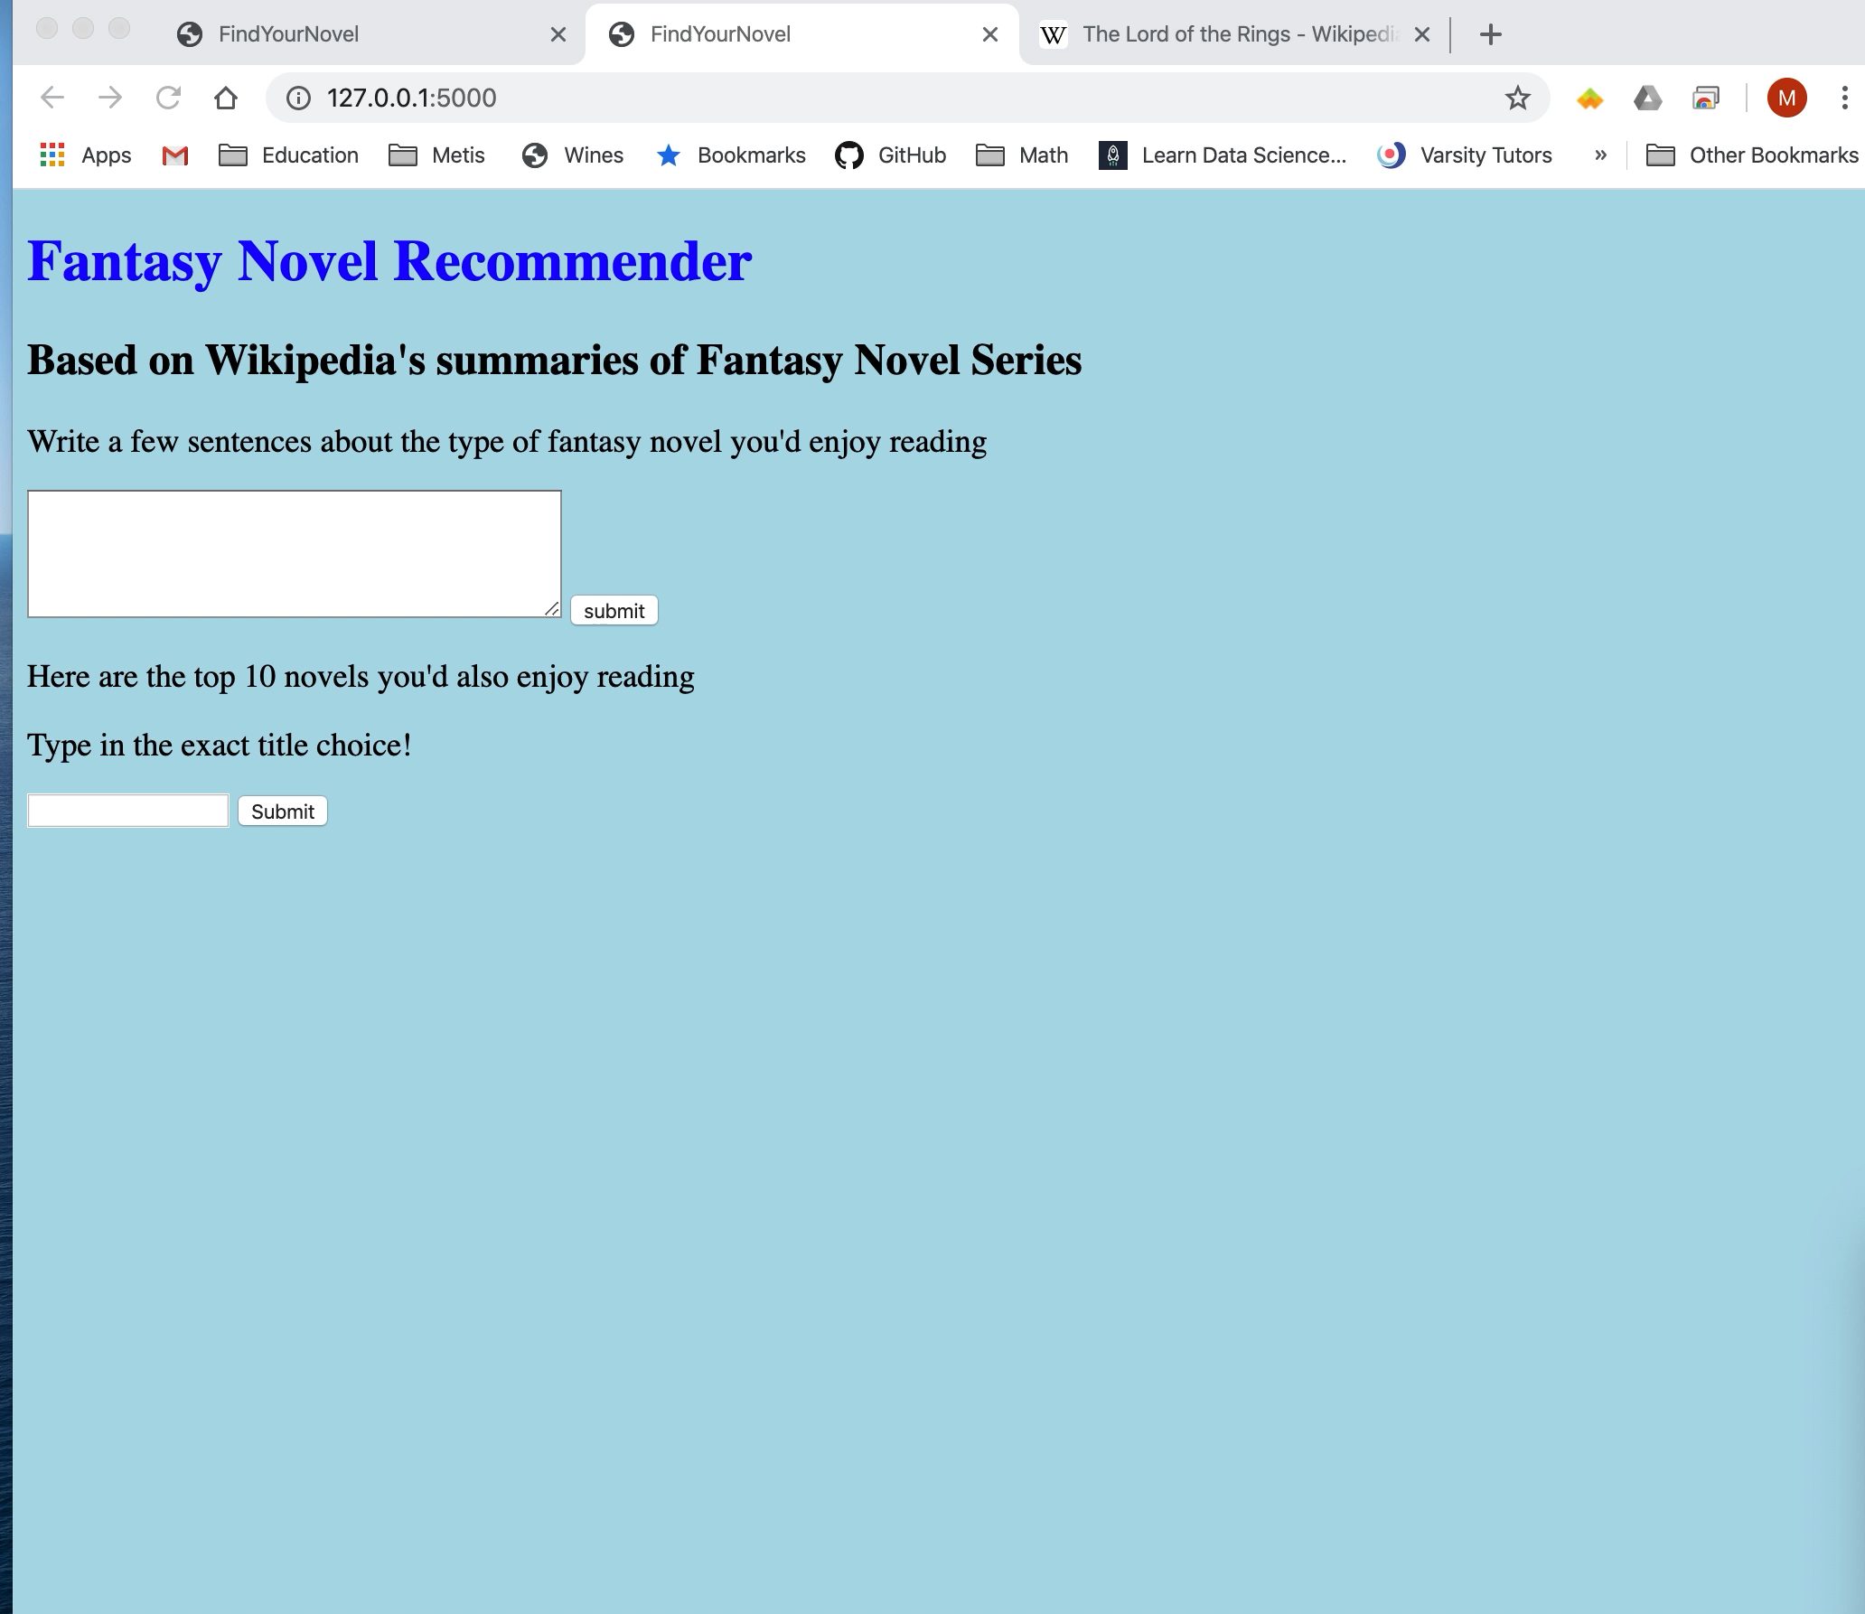
The Recommender
Will you please enter a brief excerpt from one of your favorite books?
Notes:
The recommender asks the user to input a brief excerpt
From a favorite book and returns 10 title suggestions that
Can be submitted to get to that titles Wikipedia page.

Slide 9
Take Aways:
The recommender is returning reasonable titles.
The application provides convenient access to more information.
Future Work:
Expanded genres
Apply more NLP tools: Word2Vec, gloVe
Refine Flask application
Notes:
So much more subjectivity to NLP than previous projects and
This circular process has a direct impact on the user experience.
With more artistic license I think it is especially important to
Approach each step in the process with the business question in mind and the effect on the end-user.
For future iterations of this project I’d like to expand the corpus to more genres and titles and refine the flask application.

Slide 10
Happily Ever After
Notes:
The End

Slide 11
T-SNE explained https://www.mathworks.com/help/stats/t-sne.html
Appendix
What Is t-SNE?
t-SNE (tsne) is an algorithm for dimensionality reduction that is well-suited to visualizing high-dimensional data. The name stands for t-distributed Stochastic Neighbor Embedding. The idea is to embed high-dimensional points in low dimensions in a way that respects similarities between points. Nearby points in the high-dimensional space correspond to nearby embedded low-dimensional points, and distant points in high-dimensional space correspond to distant embedded low-dimensional points. (Generally, it is impossible to match distances exactly between high-dimensional and low-dimensional spaces.)
The tsne function creates a set of low-dimensional points from high-dimensional data. Typically, you visualize the low-dimensional points to see natural clusters in the original high-dimensional data.
The algorithm takes the following general steps to embed the data in low dimensions.
Calculate the pairwise distances between the high-dimensional points.
Create a standard deviation σ_{i} for each high-dimensional point i so that the perplexity of each point is at a predetermined level. For the definition of perplexity, see Compute Distances, Gaussian Variances, and Similarities.
Calculate the similarity matrix. This is the joint probability distribution of X, defined by Equation 1.
Create an initial set of low-dimensional points.
Iteratively update the low-dimensional points to minimize the Kullback-Leibler divergence between a Gaussian distribution in the high-dimensional space and a t distribution in the low-dimensional space. This optimization procedure is the most time-consuming part of the algorithm.

Slide 12
The Elbow Method
Heuristic method of interpretation and validation of consistency within cluster analysis designed to help find the appropriate number of clusters in a dataset. It is often ambiguous and not very reliable, and hence other approaches for determining the number of clusters such as the silhouette method are preferable.
https://en.wikipedia.org/wiki/Elbow_method_(clustering)

